Slide 1

University Grants Commission has come up with a draft regulation to curb plagiarism in research and academic writing. The new policy will be called “Promotion of Academic Integrity and Prevention of Plagiarism in Higher Education Institutions Regulations, 2017” .
AIM OF NEW POLICY
— institutional mechanism for promotion of academic integrity
— develop systems to detect and prevent plagiarism
UGC’ sensitisation seminars and awareness programmes on:
1. responsible conduct of research
2. project work, assignment, thesis, dissertation, promotion of academic integrity
3. ethics in education for students, faculty and other members of academic staff

Slide 2
UGC’s Suggestions to Curb Plagiarism
1. Every HEI(Higher education institution) shall declare and implement the technology based mechanism using appropriate software.
2. Every student submitting a thesis, dissertation, term papers, reports or any other such documents to the HEI shall submit an undertaking. This will be indicating that the document has been prepared by him or her and that the document is his/her original work and free of any plagiarism
3. Every faculty, researcher and M.Phil/Ph.D students should be provided account in plagiarism-detection tools approved by the HEI.
4. Undertaking shall include that the document has been duly checked through a Plagiarism-detection tool
5. HEI to draft a policy on plagiarism and get it approved by relevant statutory bodies of the University.
6. Each supervisor shall certify that work done by the researcher under him / her is plagiarism free
7. All HEIs shall submit to INFLIBNET soft copies of all M.Phil., Ph.D. dissertations and theses carried out in its various departments after the award of degrees for hosting in the digital repository under the “Shodh Ganga e-repository” programme.
8. All HEIs shall create Institutional Repository on institute website which shall include dissertation / thesis / paper / publication and other in-house publications.

Slide 3







Turnitin
ProWritingAid
Grammarly
Paper Rater
WhiteSmoke
Copyleaks Plagiarism Checker
URKUND

Slide 4


Slide 5
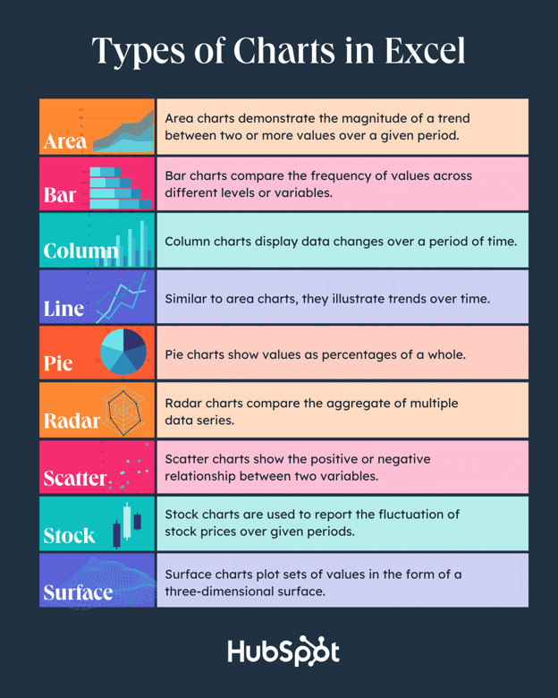

Slide 6
Choose one of nine graph and chart options to make.
Enter your data into Excel.
Highlight your data and click 'Insert' your desired graph.
Switch the data on each axis, if necessary.
Adjust your data's layout and colors.
Change the size of your chart's legend and axis labels.
Change the Y-axis measurement options, if desired.
Reorder your data, if desired.
Title your graph.
Export your graph or char

Slide 7


Slide 8
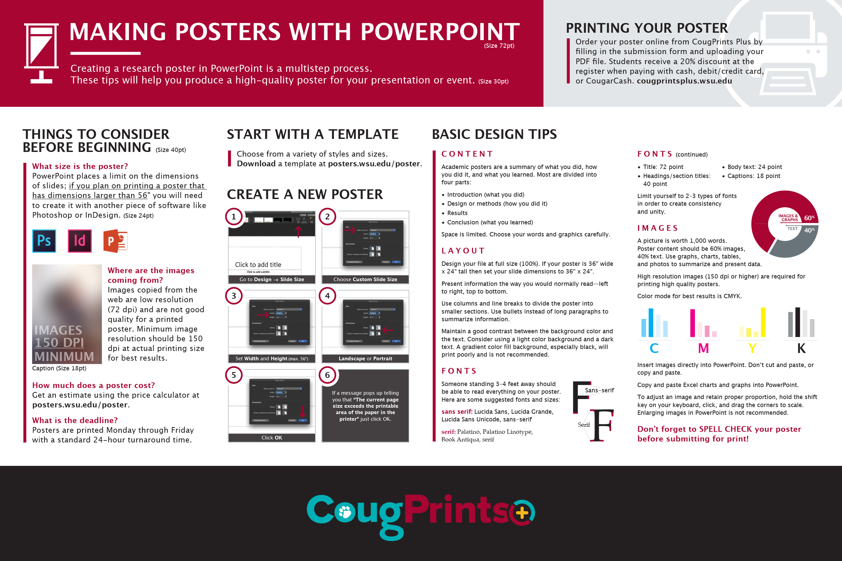

Slide 9
Choose custom dimensions
On the Design tab of the Ribbon, select Page Setup. The Page Setup dialog box opens.
Select the Slides Sized for list to open it, and then select Custom at the bottom of the list.
In the Height and Width boxes, specify the dimensions you want.

Slide 10
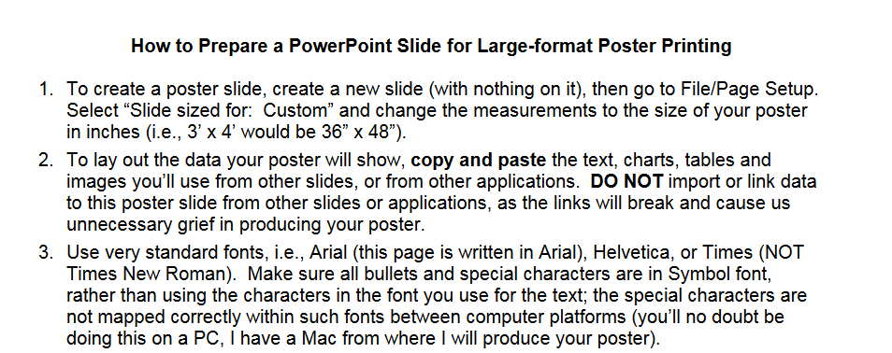

Slide 11
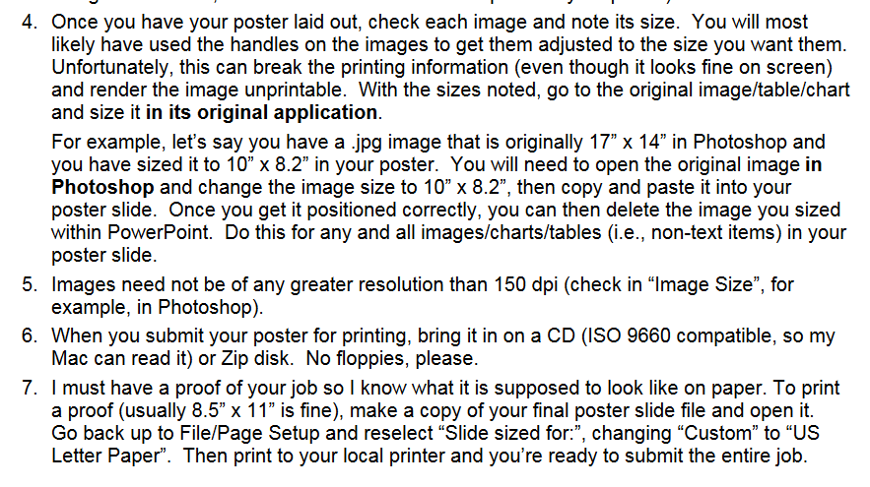

Slide 12
